Slide 1
Database Systems and Applications

Slide 2
Module 1.1: DBMS Introduction

Slide 3
Agenda
Database System
DBMS
Database System Environment
Advantages of DBMS over File Systems
Three Schema Architecture
Data Independence
Structure of DBMS
Users of DBMS
Data Model

Slide 4
Database Management System (DBMS)
Data: Known facts that can be recorded and have an implicit meaning; (raw)
Information: Processed Data
Database: a highly organized, interrelated, and structured set of data about a particular enterprise
Controlled by a database management system (DBMS)
DBMS: Database management system (DBMS) is software that is used to manage databases.
Set of programs to access the data
An environment that is both convenient and efficient to use
Database systems are used to manage collections of data that are:
Highly valuable
Relatively large
Accessed by multiple users and applications, often at the same time.
A modern database system is a complex software system whose task is to manage a large, complex collection of data

Slide 5
Overview of Database Systems
What is a Database?
A shared collection of logically related data along with the description of the data that suits to the needs of large enterprises.
Data - known facts that can be recorded and have implicit meaning.
Eg.
Name, Telephone number and Address of your friends.
Account number, Name of the account holder and Balance in a banking system.

Slide 6
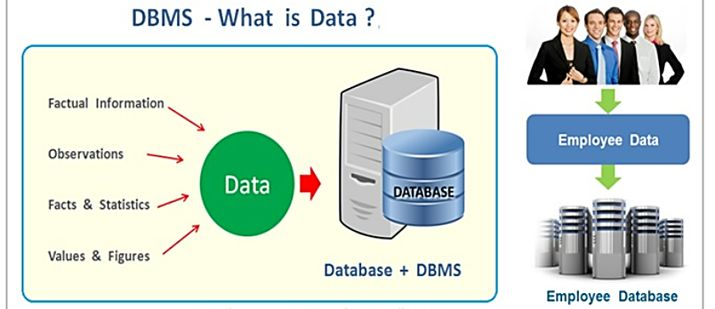
What is Data?

Slide 7
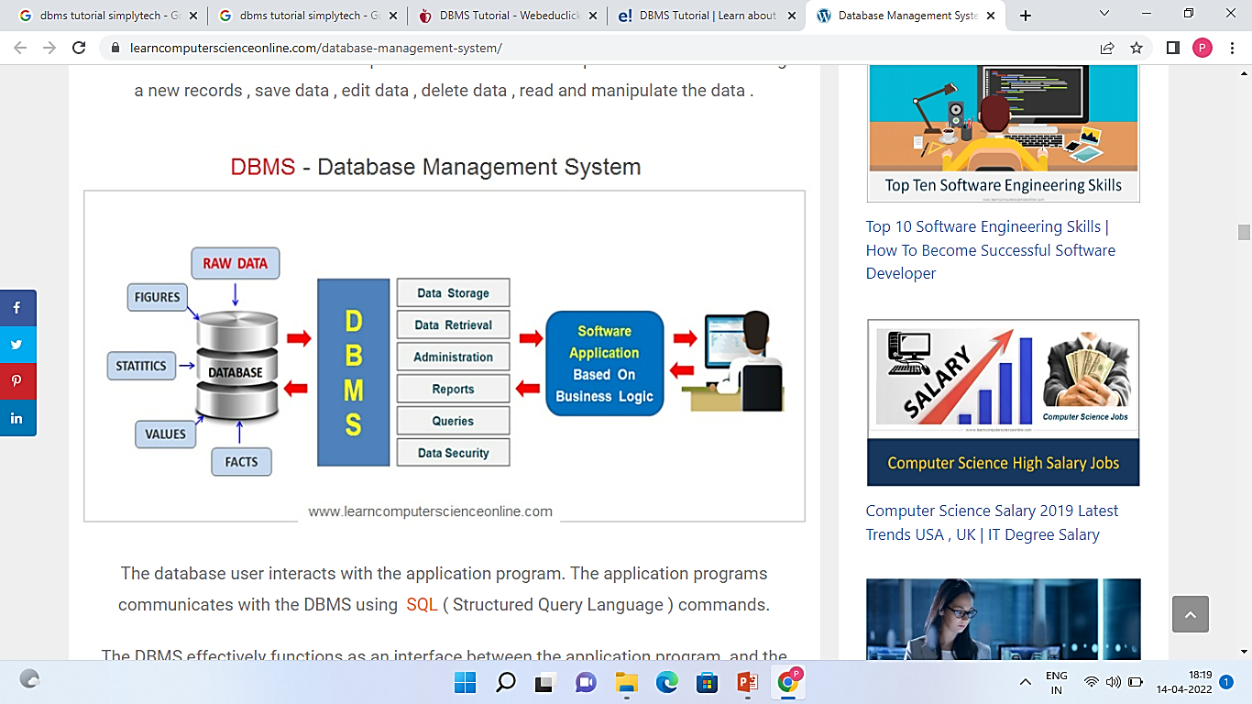
Database Management System

Slide 8
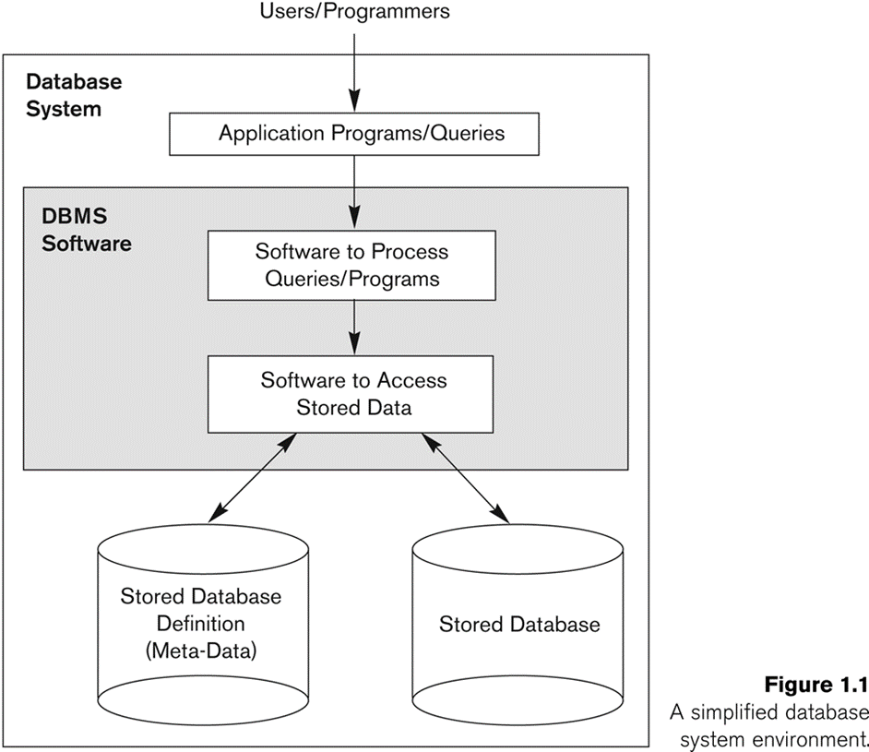
Simplified database system environment

Slide 9
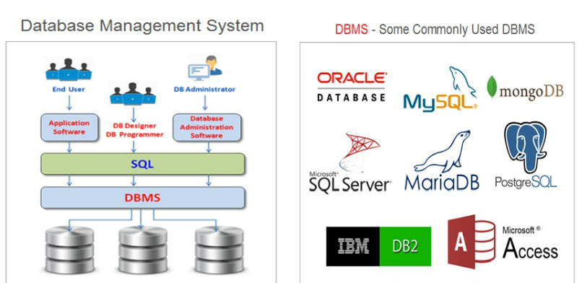
Database system environment

Slide 10
DBMS Functionality
Define a particular database in terms of its data types, structures, and constraints
Construct or Load the initial database contents on a secondary storage medium
Manipulating the database:
Retrieval: Querying, generating reports
Modification: Insertions, deletions and updates to its content
Accessing the database through Web applications
Processing and Sharing by a set of concurrent users and application programs – yet, keeping all data valid and consistent
Protection or Security measures to prevent unauthorized access
Presentation and Visualization of data
Maintaining the database and associated programs over the lifetime of the database application

Slide 11
Example of a Database (with a Conceptual Data Model)
Mini-world for the example:
Part of a UNIVERSITY environment.
Some mini-world entities:
STUDENTs
COURSEs
SECTIONs (of COURSEs)
(academic) DEPARTMENTs
INSTRUCTORs

Slide 12
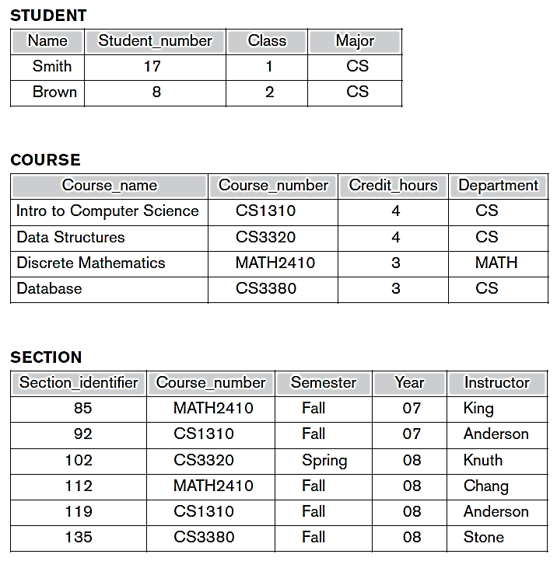
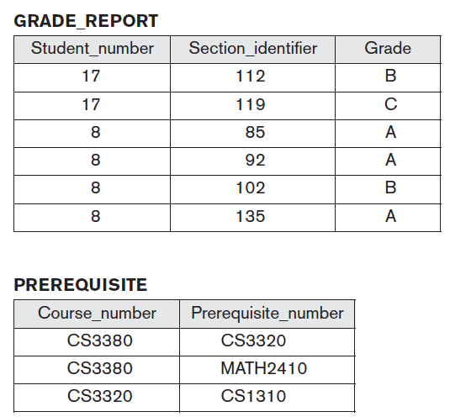
Example of a simple database

Slide 13
Characteristics of the Database Approach
Self-describing nature of a database system:
A DBMS catalog stores the description of a particular database (e.g. data structures, types, and constraints)
The description is called meta-data.
This allows the DBMS software to work with different database applications.
Insulation between programs and data:
Called program-data independence.
Allows changing data structures and storage organization without having to change the DBMS access programs.

Slide 14
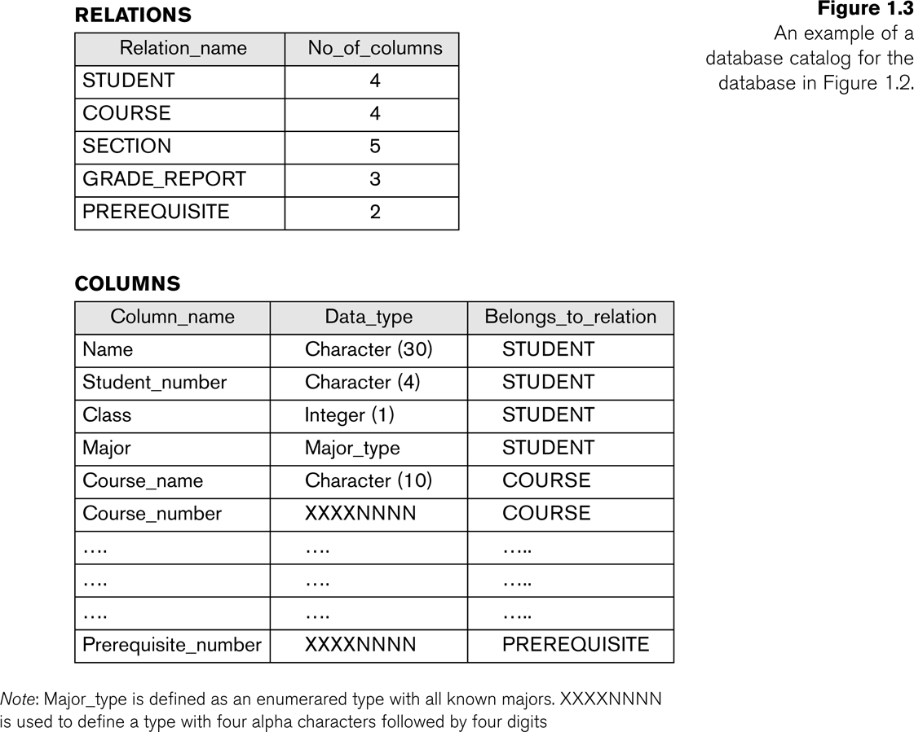
Example of a simplified database catalog

Slide 15
Early File Systems Vs DBMS
File System approach
DBMS approach

Slide 16
Main Characteristics of the Database Approach (continued)
Data Abstraction:
A data model is used to hide storage details and present the users with a conceptual view of the database.
Programs refer to the data model constructs rather than data storage details
Support of multiple views of the data:
Each user may see a different view of the database, which describes only the data of interest to that user.
Sharing of data and multi-user transaction processing:
Allowing a set of concurrent users to retrieve from and to update the database.
Concurrency control within the DBMS guarantees that each transaction is correctly executed or aborted
Recovery subsystem ensures each completed transaction has its effect permanently recorded in the database
OLTP (Online Transaction Processing) is a major part of database applications. This allows hundreds of concurrent transactions to execute per second.

Slide 17
Drawbacks of using file systems
Data redundancy and inconsistency
Multiple file formats, duplication of information in different files
Difficulty in accessing data
Need to write a new program to carry out each new task
Data Isolation
Multiple files and formats
Integrity problems
Integrity constraints (e.g., account balance > 0) become “buried” in program code rather than being stated explicitly
Hard to add new constraints or change existing ones.

Slide 18
Drawbacks of using file systems (continued..)
Atomicity of updates
Failures may leave database in an inconsistent state with partial updates carried out
Example: Transfer of funds from one account to another should either complete or not happen at all
Concurrent access by multiple users
Concurrent access needed for performance
Uncontrolled concurrent accesses can lead to inconsistencies
Example: Two people reading a balance (say 100) and updating it by withdrawing money (say 50 each) at the same time
Security problems
Hard to provide user access to some, but not all, data

Slide 19
Advantages of Using the Database Approach
Controlling redundancy in data storage and in development and maintenance efforts.
Sharing of data among multiple users.
Restricting unauthorized access to data.
Providing persistent storage for program Objects (In Object-oriented DBMSs)
Providing Storage Structures (e.g. indexes) for efficient Query Processing
Providing backup and recovery services.
Providing multiple interfaces to different classes of users.
Representing complex relationships among data.
Enforcing integrity constraints on the database.
Drawing inferences and actions from the stored data using deductive and active rules

Slide 20
Additional Implications of Using the Database Approach
Potential for enforcing standards
This is very crucial for the success of database applications in large organizations. Standards refer to data item names, display formats, screens, report structures, meta-data (description of data), Web page layouts, etc.
Reduced application development time
Incremental time to add each new application is reduced.
Flexibility to change data structures
Database structure may evolve as new requirements are defined.
Availability of current information
Extremely important for on-line transaction systems such as airline, hotel, car reservations.

Slide 21
DBMS Schema
DBMS Schema
A database schema is the skeleton structure that represents the logical view of the entire database. It defines how the data is organized and how the relations among them are associated. It formulates all the constraints that are to be applied on the data.
Schemas commonly use visual representations to communicate the architecture of the database, becoming the foundation for an organization’s data management discipline.
The database schema includes the definition of the database, record types (entities), and the components that make up those records.
Schema of a database does not change by performing certain operations like insertion, updation, and deletion, but it can only be modified or changed by modifying the DDL statements.

Slide 22
DBMS Instance
Instance
The data or information stored in the database at a particular moment is called an “instance of the database” it also called as a current state or database state.
The database schema defines the variables in tables that belong to a specific database; the values or records of these variables at a particular moment are called the instance of the database.
Every time we insert, modify, or delete the value of data item in a record, one state of data changes into another state

Slide 23
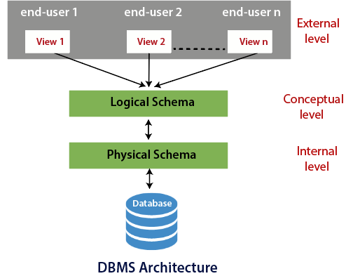
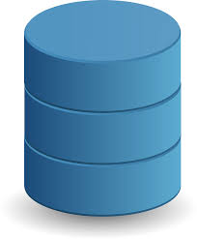
Three schema Architecture
Database

Slide 24
Physical Level
The lowest level of architecture of a database system is the physical level, also known as the internal level.
This physical level answer the questions how the data is stored in the database ?
The data is stored in the external hard drives in bits and bytes at the physical level.
The physical level is also responsible for the Compression and Encryption of data.
Physical level indirectly used to describe complex level data structure in detail.

Slide 25
Conceptual Level
The conceptual level is also known as the logical level.
The conceptual level of architecture of a database system specifies the relationships between various data tables and describes how the database looks to the users conceptually.
The conceptual level does not have any relation to how the data in the database is stored.
The conceptual level answer the question what data is stored in the database ?
The conceptual level of database architecture describes the structure of the whole database.
At a conceptual level, internal detail such as the implementation of data is hidden. This concept is also known as data abstraction.
Generally, programmer and administrator work at conceptual or logical level.

Slide 26
External Level
The highest level in the 3 tier architecture of DBMS is the external level and closest to the user. It is also called the view level or superficial level.
This schema also contains subschema. Each subschema describes each view of the database.
External level shows only the relevant data to the users in the form of views and hides the remaining data.
All individual user can see the data as a different view as per their requirements.
External level of three schema architecture in DBMS describes database part that a user or a particular group of the user is interested in and hide remaining database from that user or group of user.

Slide 27
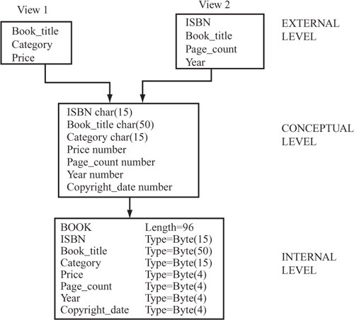
Example

Slide 28
Data Independence
When a schema at a lower level is changed, only the mappings between this schema and higher-level schemas need to be changed in a DBMS that fully supports data independence.
The higher-level schemas themselves are unchanged.
The application programs need not be changed since they refer to the external schemas.
Data Independence is the property of DBMS that helps you to change the Database schema at one level of a database system without requiring to change the schema at the next higher level.

Slide 29
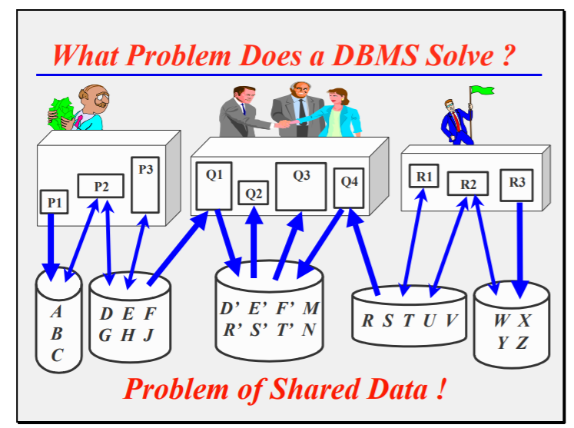
Program-Data Independence
The “centre” application is assumed to be built after the other two

Slide 30
What are the Problems?
Duplicate Data common to 2 or more applications
Applications Constrained by Existing Data or Applications
Where data already exists, newer applications are constrained to use it, to minimize data input and storage
Duplicate data leads to Inconsistent Data, or Updating Overheads.
If the updating of all copies is not synchronized, they will become inconsistent.
Constraining applications leads to Reduced Performance and/or Excessive Maintenance.
Although each application may be well planned, the overall data storage situation will become complex and ill thought-out because it is unplanned

Slide 31
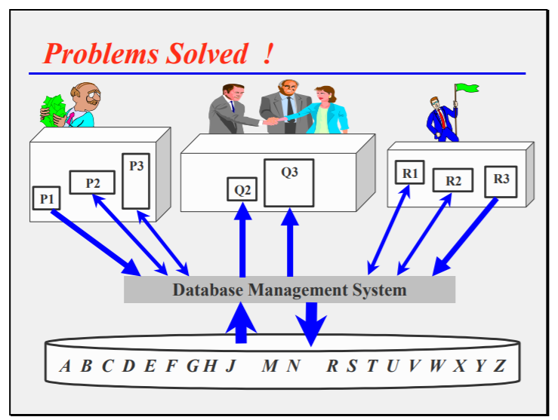
Program-Data Independence (contd.)

Slide 32
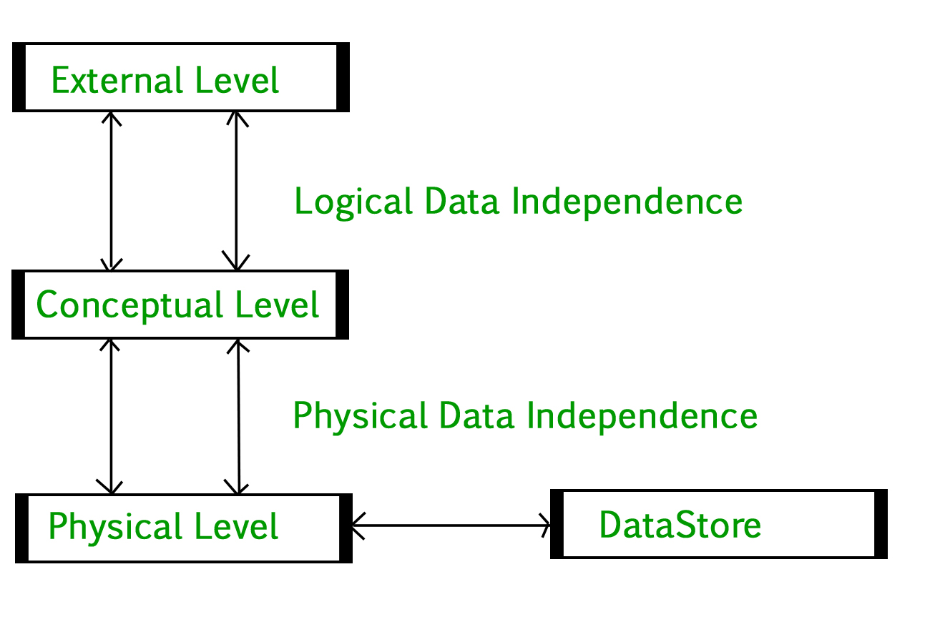
Types Of Data Independence
Logical Data Independence
The capacity to change the conceptual schema without having to change the external schemas and their application programs.
Only the view definition and mapping head to be changed in DBMS.
Example:- We may change the conceptual schema by removing a data item, the external schemas that refer only to the remaining data should not be affected.
Physical Data Independence
The capacity to change the internal schema without having to change the conceptual schema.
Physical independence, you can easily change the physical storage structures or devices with an effect on the conceptual schema but not on external schema.
Example:-Using a new storage device like Hard Drive or Magnetic Tapes
Modifying indexes

Slide 33
Importance of Data Independence
It helps to improve the quality of the data.
Database system maintenance becomes affordable.
Enforcement of standards and improvement in database security.
You don’t need to alter data structure in application programs.
Permit developers to focus on the general structure of the Database rather than worrying about the internal implementation.
It allows to improve state which is undamaged or undivided
Database incongruity is vastly reduced.
Easily make modifications in the physical level is needed to improve the performance of the system.

Slide 34
DBMS COMPONENT MODULES
Stored data manager
DDL compiler
Interactive query interface
Query compiler
Query optimizer
Precompiler
Runtime database processor
System catalog
Concurrency control system
Backup and recovery system

Slide 35
DBMS Environment
Web Forms
Front-End
SQL I/f
SQL Commands
Plan Executor
Parser
SQL Engine
Operator Evaluator
Optimizer
Tx
Manager
Files & Access
Recovery
Manager
Buffer Manager
Lock
Manager
Disk Space Manager
DBMS
Data File
Catalog
Database

Slide 36
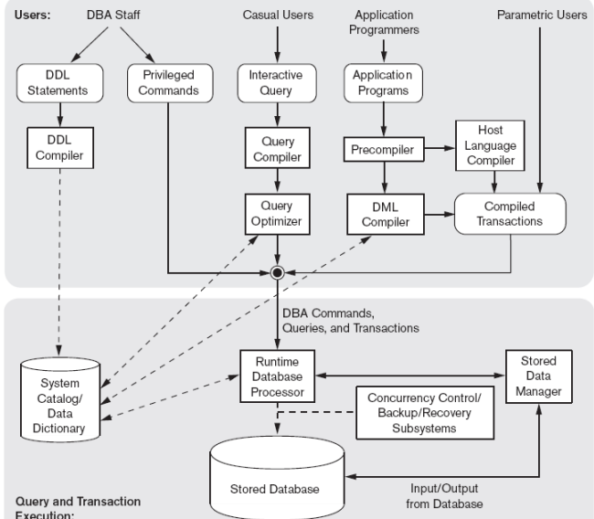
DBMS Component Module
DML Compiler :- compilation of DML commands into object code.
Runtime database processor:- handles database access at runtime.
Stored data manager:-- data transfer between disk and main memory.

Slide 37
Database System Utilities
Common utilities have the following types of function :
Loading :- i) Used to load existing data files into the database.
ii) The source file format and the target data file structure
are mentioned to the utility
Automatically reformats the data
stores it in the database.

Slide 38
Database System Utilities
Backup
Creates a backup copy of the database
Incremental backups are often used ,thought it is complex it saves space.
Database storage reorganization
Reorganize a set of database files into different file organizations
Performance monitoring
Monitors database usage and provides statistics to the DBA

Slide 39
Storage Management
Storage manager :- It is a program module that provides the interface between the low-level data stored in the database and the application programs and queries submitted to the system.
The storage manager is responsible to the following tasks:
Interaction with the OS file manager
Efficient storing, retrieving and updating of data
Issues:
Storage access
File organization
Indexing and hashing

Slide 40
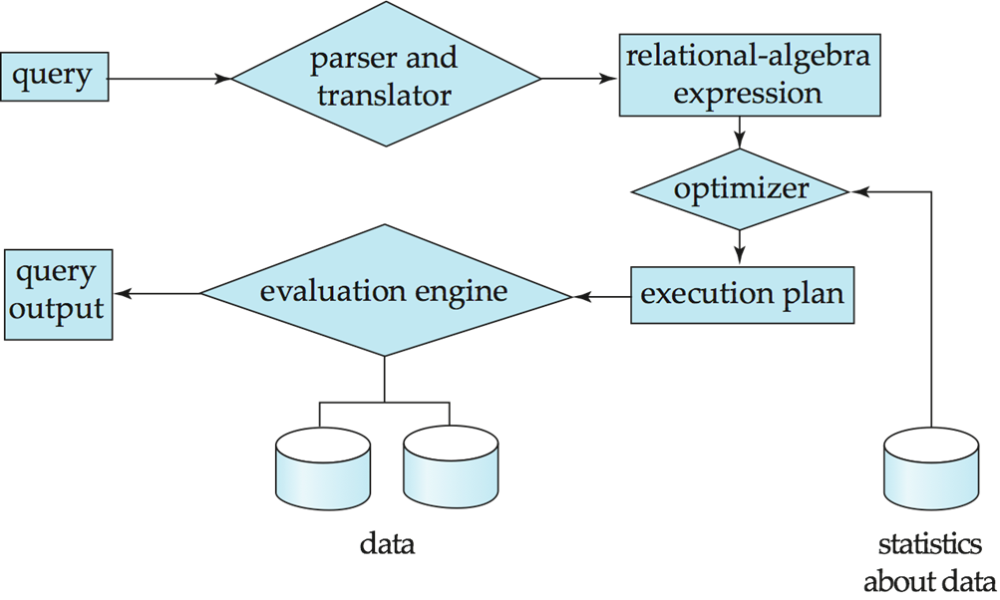
Query Processing
1. Parsing and translation
2. Optimization
3. Evaluation

Slide 41
Query Processing (Cont.)
Alternative ways of evaluating a given query
Equivalent expressions
Different algorithms for each operation
Cost difference between a good and a bad way of evaluating a query can be enormous
Need to estimate the cost of operations
Depends critically on statistical information about relations which the database must maintain
Need to estimate statistics for intermediate results to compute cost of complex expressions

Slide 42
Transaction Management
A transaction is a collection of operations that performs a single logical function in a database application
Transaction-management component ensures that the database remains in a consistent (correct) state despite system failures (e.g., power failures and operating system crashes) and transaction failures.
Concurrency-control manager controls the interaction among the concurrent transactions, to ensure the consistency of the database.

Slide 43
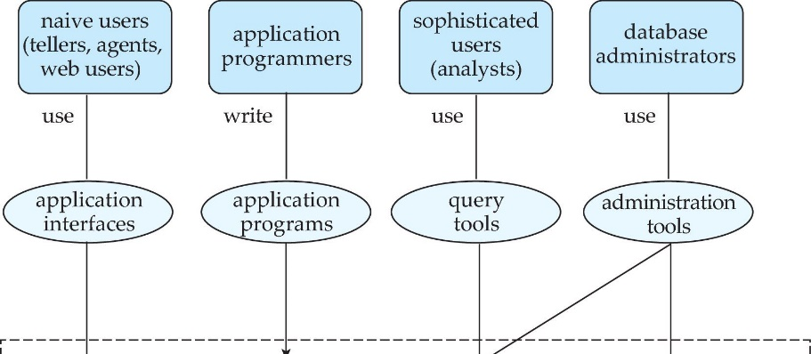
Database Users and Administrators

Slide 44
Database User
Casual users
These are people who use the database occasionally.
Naive users
These are users who constantly querying and updating the database.
Eg. Reservation Clerks of Airline, Railway, Hotel, etc.
Clerks at receiving station of Courier service, Insurance agencies, etc.
Sophisticated Users
People who use for their complex requirements.
Eg. Engineers, Scientists, Business analysts…
Standalone Users
Who maintain database for personal use.

Slide 45
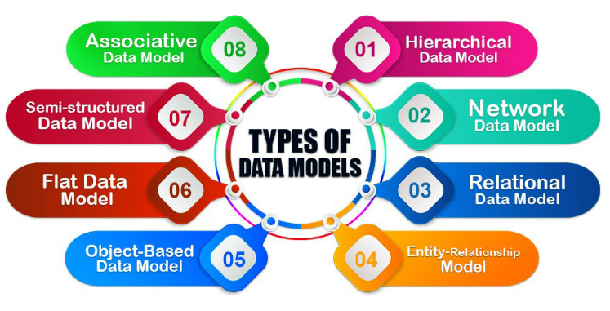
Data Models
A model is an abstraction procedure that hides superfluous information while highlighting records pertinent to the software at hand.
Data modeling is used for performing entities of interest and their relationship within the database.

Slide 46
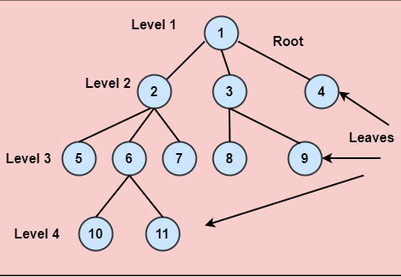
Hierarchical Model
Hierarchical Model was the first DBMS model.
This model organizes the data in the hierarchical tree structure.
The hierarchy starts from the root which has root data and then it expands in the form of a tree adding child node to the parent node

Slide 47
Hierarchical Model
Advantages of Hierarchical Model
It is very simple and fast to traverse through a tree-like structure.
Any change in the parent node is automatically reflected in the child node so, the integrity of data is maintained.
Disadvantages of Hierarchical Model
Complex relationships are not supported.
As it does not support more than one parent of the child node so if we have some complex relationship where a child node needs to have two parent node then that can't be represented using this model.
If a parent node is deleted then the child node is automatically deleted.

Slide 48
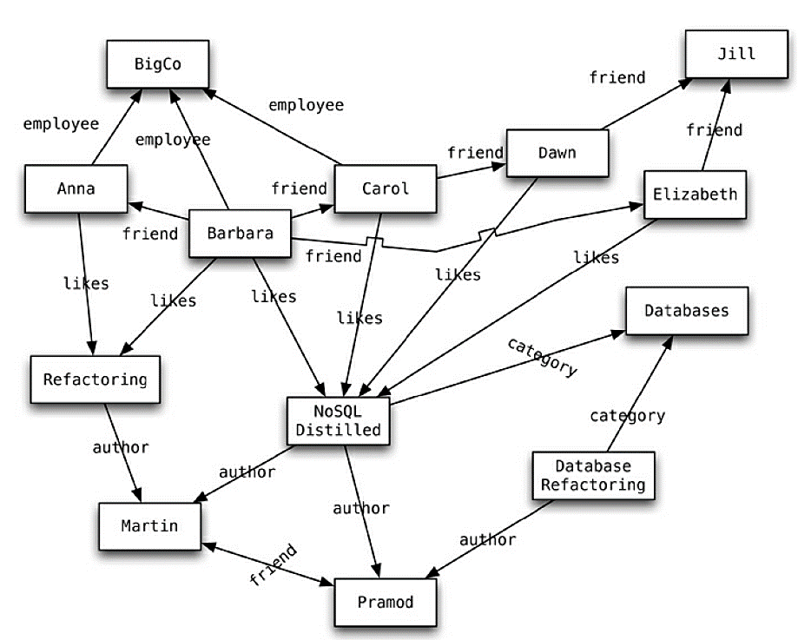
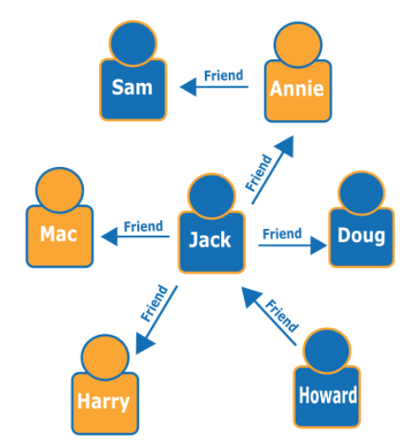
Network Model
This model is an extension of the hierarchical model. It was the most popular model before the relational model
This model is the same as the hierarchical model, the only difference is that a record can have more than one parent
It replaces the hierarchical tree with a graph.

Slide 49
Network Model
Advantages of Network Model
The data can be accessed faster as compared to the hierarchical model. This is because the data is more related in the network model and there can be more than one path to reach a particular node. So the data can be accessed in many ways
As there is a parent-child relationship so data integrity is present. Any change in parent record is reflected in the child record.
Disadvantages of Network Model
As more and more relationships need to be handled the system might get complex. So, a user must be having detailed knowledge of the model to work with the model.
Any change like updating, deletion, insertion is very complex.

Slide 50
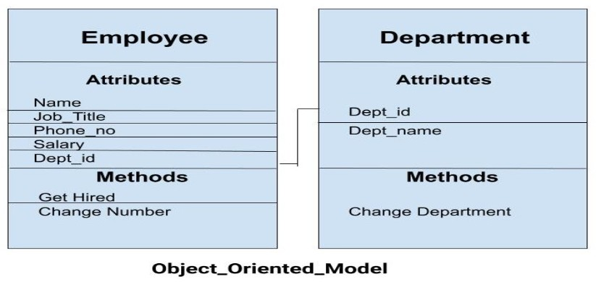
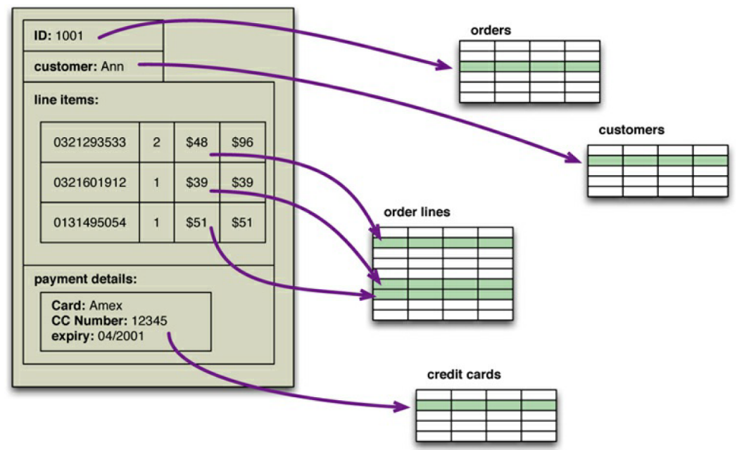
Object-Oriented Data Model
In this model, both the data and relationship are present in a single structure known as an object.
In this model, two or more objects are connected through links. We use this link to relate one object to other objects.
An object includes values saved in an instance variable within the object.

Slide 51
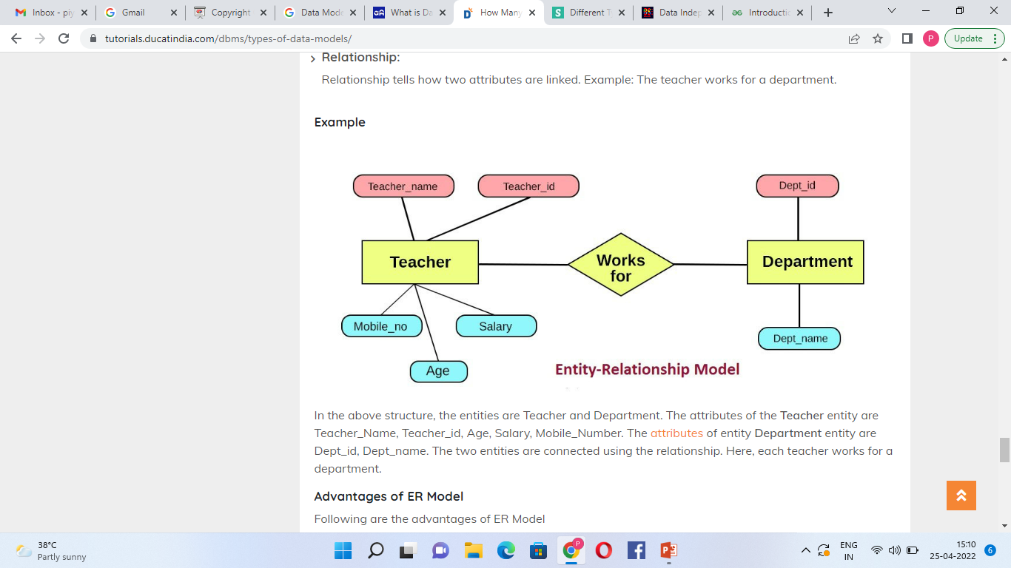
Entity-Relationship Model
Entity-Relationship Model or simply ER Model is a high-level data model diagram.
In this model the real world problem in the diagrammatical form to make it simple for recognize.
ER Diagram have three elements
1) Entity 2) Attributes 3)Relationship

Slide 52
Entity-Relationship Model
Advantages of ER Model
Simple
Effective communication tool
Easy conversion to any model
Disadvantages of ER Model
No industry standard for notation
Hidden Information

Slide 53
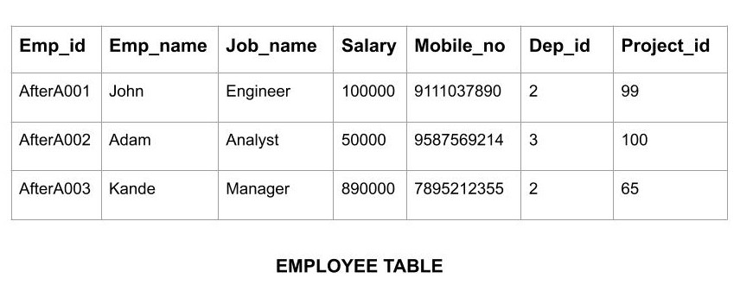
Relational Model
Relational Model is the most widely used model.
The data is maintained in the form of a two-dimensional table.
All the information is stored in the form of row and columns , Each row in the table is called tuple and column is called as attributes or field.
All the information is stored in the form of row and columns.

Slide 54
Relational Model
Advantages of Relational Model
Simple
Scalable
Structural Independence
Disadvantages of Relational Model
Hardware Overheads
Bad Design : The relational model is very easy to design and use

Slide 55
Database Language
Data Definition Language (DDL):
Used by the DBA and database designers to specify the conceptual schema of a database.
In many DBMSs, the DDL is also used to define internal and external schemas (views). In some DBMSs, separate storage definition language (SDL) and view definition language (VDL) are used to define internal and external schemas.
Data Manipulation Language (DML): Used to specify database retrievals and updates.
DML commands (data sublanguage) can be embedded in a general-purpose programming language (host language), such as COBOL, C or an Assembly Language.
Alternatively, stand-alone DML commands can be applied directly (query language).

Slide 56
Database Language
Data Control Language (DCL)
Data Control Language (DCL) is a set of special commands that are used to control the user privileges in the database system
Transaction Control Language (TCL)
A transaction is a collection of related tasks that are treated as a single execution unit by the DBMS software

Slide 57


